Slide 1
Test-Driven Development
Sachi Williamson, Cloud DevOps Consultant
Steven Borg, Co-Founder and Strategist

Slide 2

Sachi Williamson
Cloud DevOps Consultant at Northwest Cadence
Sachi.Williamson@nwcadence.com | @sawpresto
Product owner for NWC Knowledge Library product
Enjoys training and implementing continuous delivery pipelines
Biases:
Believes that “one size fits all” doesn’t work
“Failures” are learning opportunities – especially as an ice hockey goalie
@sawpresto

Slide 3


Steven Borg
Co-Founder and Strategist at Northwest Cadence
Steven.Borg@nwcadence.com | @stevenborg
Presenter at several Microsoft Virtual Academy sessions
Lean software development, Git, Kanban and other topics
Microsoft ALM MVP for 11 years
Biases:
Prefer starting with the ‘big picture’
Enjoy math and think it’s both fun and useful
@stevenborg

Slide 4
Agenda
1
Types of automated tests
6
Working with legacy code
2
Test-Driven Development in a nutshell
7
TDD Patterns and Practices
3
Unit testing and Test-Driven Development
8
Extending TDD
4
Advanced Unit Testing
5
What qualities make up good tests?

Slide 5
Setting expectations
Target audience:
Developers, Testers
Objective
Foundational knowledge of Test-Driven Development

Slide 6
Join the MVA community!

Slide 7
Test-Driven Development in a nutshell

Slide 8
“Test Driven-Development: Clean code that works.” – Ron Jeffries

Slide 9


Test-Driven Development
Integrate testing into the development process
Tests define what code will do
Tests come from specifications
Write code to pass tests
Don't write code that doesn't contribute to passing a test
Code

Slide 10
Two simple rules:
Write new code only if an automated test has failed
Eliminate duplication

Slide 11
Red/Green/Refactor
Write a failing unit test.
Red
Green
Refactor
Refactor your draft code
into a final version
Code just enough to
make the unit test pass

Slide 12
Red/Green/Refactor
Start
Write a new test
Compile
Fix compile errors
Run the test (Fails)
Write the target code
Run the test (Pass)
Refactor as needed

Slide 13
Red/Green/Refactor - revisited
Write a failing unit test.
Write a Test
Make it Run
Make it Right
Refactor your draft code
into a final version
Code just enough to
make the unit test pass

Slide 14
The steps
Quickly add a test.
Run all tests and see the new one fail.
Make a little change.
Run all tests and see them succeed.
Refactor to remove duplication

Slide 15
Who is this for?
Developers who want to write better code
Programmers who want to have confidence in code

Slide 16
Why does TDD work?
Reduces defects by finding and fixing bugs earlier
Shortens feedback loop on design decisions

Slide 17
Value prop of TDD
Predictable process for development
More intentional development
Improve long-term maintainability of both code and tests
Guarantee good unit test coverage of your code

Slide 18
Other takeaways
Create to-do lists for tests
Take small, incremental steps
Be patient

Slide 19
Fibonacci

Slide 20
Fibonacci
Designing the Fibonacci in C#

Slide 21
Bowling Kata

Slide 22
Bowling Kata
Exercise for using test-driven development with a commonly-known activity
Popularized by Uncle Bob Martin

Slide 23
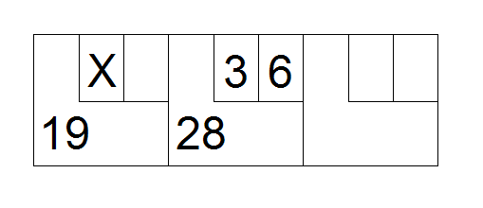
Bowling Kata - Scoring
10 frames
2 rolls of the ball to knock down 10 pins
Score for each frame = Total number of pins knocked down + bonus for strike/spare
Spare = All 10 pins knocked down in 2 rolls
Bonus = Number of pins knocked down in next roll
Strike = All 10 pins knocked down on first try
Bonus = Value of next 2 rolls
In 10th frame, if spare or strike, can roll an extra time (up to 3)
https://commons.wikimedia.org/wiki/File:Bowlstrike.PNG

Slide 24
Bowling Kata - Design
Class named “Game”
roll (pins: int) – called each time player rolls a ball, argument is number of pins knocked down
score() : int – called only at end of game, returns total score

Slide 25
Bowling Kata - Design

Slide 26
Bowling Kata
Designing the Bowling Kata in C#

Slide 27

Test-Driven Development by Example
Test-Driven Development By Example by Kent Beck
http://ecx.images-amazon.com/images/I/51H4NaRMF4L._SX258_BO1,204,203,200_.jpg

Slide 28
Test Driven Development isn’t a silver bullet.

Slide 29
Types of automated tests

Slide 30
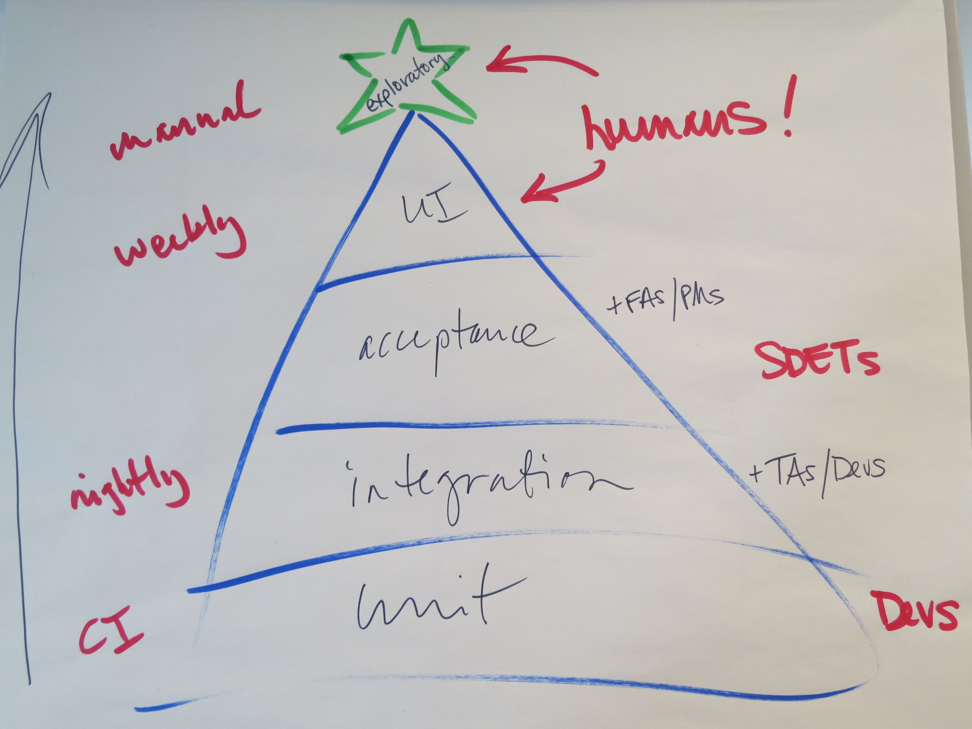
The testing tree

Slide 31
Types of automated tests
Unit tests
Integration tests
User Interface (UI) tests
Web performance tests
Load tests

Slide 32
Unit tests – a definition
A unit test is an automated piece of code that invokes a unit of work in the system and then checks a single assumption about that behavior of that unit of work.
What makes a good unit test?
Automated and repeatable
Simple to implement
Maintainable
Available, anyone should be able to run it
Runs at the push of a button (or automatically)
Runs quickly
Runs in memory
Source: The Art of Unit Testing, Roy Osherove

Slide 33
Integration tests – a definition
An integration test validates two or more dependent software modules as a group in multiple ways.
What makes a good unit test?
Automated and repeatable
Simple to implement
Maintainable
Available, anyone should be able to run it
Runs at the push of a button (or automatically)
Runs quickly
Runs in memory

Slide 34
Automated UI tests – a definition
An automated user interface test drives the application UI to validate user specifications.
What makes a good automated UI test?
Automated and repeatable
Simple to implement
Maintainable
Available, anyone should be able to run it
Runs at the push of a button (or automatically)
Runs quickly
Runs in memory

Slide 35
Web performance tests – a definition
A performance test validates an application’s responsiveness, throughput, reliability, and scalability.
What makes a good performance test?
Automated and repeatable
Simple to implement
Maintainable
Available, anyone should be able to run it
Runs at the push of a button (or automatically)
Runs quickly
Runs in memory

Slide 36
Load tests – a definition
A load test puts demands on a system to determine behavior under varying levels of load, identify bottlenecks, and validate expected performance.
What makes a good load test?
Automated and repeatable
Simple to implement
Maintainable
Available, anyone should be able to run it
Runs at the push of a button (or automatically)
Runs quickly
Runs in memory

Slide 37
Unit testing and Test-Driven Development

Slide 38
Unit tests – a definition
A unit test is an automated piece of code that invokes a unit of work in the system and then checks a single assumption about that behavior of that unit of work.
What makes a good unit test?
Automated and repeatable
Simple to implement
Maintainable
Anyone should be able to run it
Runs at the push of a button (or automatically)
Runs quickly
Runs in memory
Source: The Art of Unit Testing, Roy Osherove

Slide 39
Another definition of a unit test
From The Art of Unit Testing by Roy Osherove:
Unit test – An automated piece of code that invokes the method or class being tested and then checks some assumptions about the logical behavior of that method or class. A unit test is almost always written using a unit-testing framework. It can be written easily and runs quickly. It’s fully automated, trustworthy, readable, and maintainable.

Slide 40
Anatomy of a unit test
Indicates a test
method
[TestMethod()]
public void WhenXHappens_GivenY_ResultShouldBeZ()
{
//arrange
Thing newThing = new Thing();
//act
newThing.doSomething();
//assert
Assert.AreEqual("Actual",newThing.toString());
}
Descriptive method
name
Set up the variables &
objects for the test
Perform the test
action(s)
Assert that the
expected result
occurred.

Slide 41
Unit Tests must be...
Automatic
they check their own results
Repeatable
able to be run again and again, by multiple people
Available
they should accompany the code they test, so anybody who has that code can run them

Slide 42
The power of unit tests
Reduce technical debt.
Identify coupled code.
Enable refactoring without fear.
Document what your code really does.
Improve automated builds.

Slide 43







Use the framework you want to use
In the box support for
.NET
Native C/C++
Third party plugins
NUnit
xUnit.net
MbUnit
QUnit/Jasmine
SQL Server Unit Testing
Under development

Slide 44
Advanced Unit Testing

Slide 45
Stubs, Mock Objects, and Isolation Frameworks

Slide 46
Stubs
External dependencies – Object in system that code under test interacts with and over which you have no control (e.g. file systems, threads, memory, libraries)
Stub – Controllable replacement for existing dependencies. Test code without dealing with dependency directly
Example: Training astronauts into space

Slide 47
Mock Objects
Isolate your test to a unit’s scope
Control the behavior of other code being called
Keep from calling externals you don’t want to hit (or must not hit) during test execution
Stubs != Mocks

Slide 48
Stubs vs. Mock Objects
From Martin Fowler’s article, “Mocks aren’t stubs:”
Stubs – Provide canned answers to calls made during the tests, usually not responding at all to anything outside what’s programmed in for the test.
Mocks – Objects pre-programmed with expectations which form a specification of the calls they are expected to receive.
Stubs -> state verification
Mocks -> behavior verification
http://www.martinfowler.com/articles/mocksArentStubs.html

Slide 49
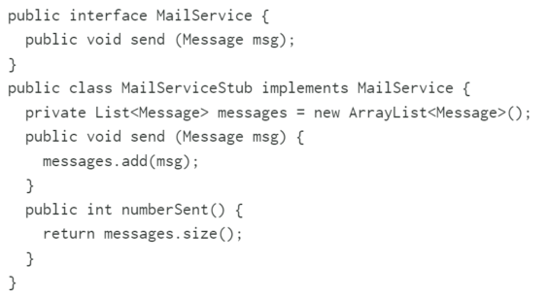
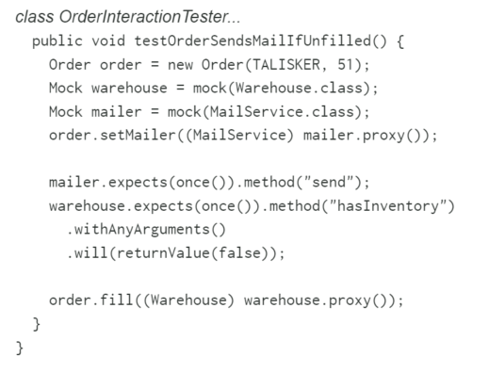
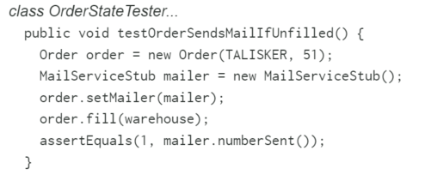
Stubs vs. Mock Objects (cont.)
Stubs Mocks
http://www.martinfowler.com/articles/mocksArentStubs.html

Slide 50
Dynamic mocks basics
Dynamic mocks intercept behavior via delegates
Specify the mock behavior you want
Create mocks on the fly, without the overhead of building out full mock classes
Mock the same type of object different ways for different test cases
To be mockable, stuff must be virtual
“To mock a type, it must either be an interface (this is also called being pure virtual) or have virtual members (abstract members are also virtual).
By this definition, you can mock everything which is virtual.”
http://stackoverflow.com/questions/1972831/to-mock-an-object-does-it-have-to-be-either-implementing-an-interface-or-marked/1973482#1973482

Slide 51
Dynamic mocking types
Loose
Delegates the calls you specify – behavior for unspecified calls depends
Preferred for flexibility – if you rewrite unrelated behaviors, your mock still works
Strict
Fails the test if anything is called on your mock that you didn’t specify a delegate for
Less flexible, but an awesome way to add new tests to unfamiliar code

Slide 52
Partial mocks
Partial
Allows some behaviors to be mocked and others passed through to the base type
Not all frameworks support it
Can’t be done on an interface – must mock the class where the behaviors are

Slide 53
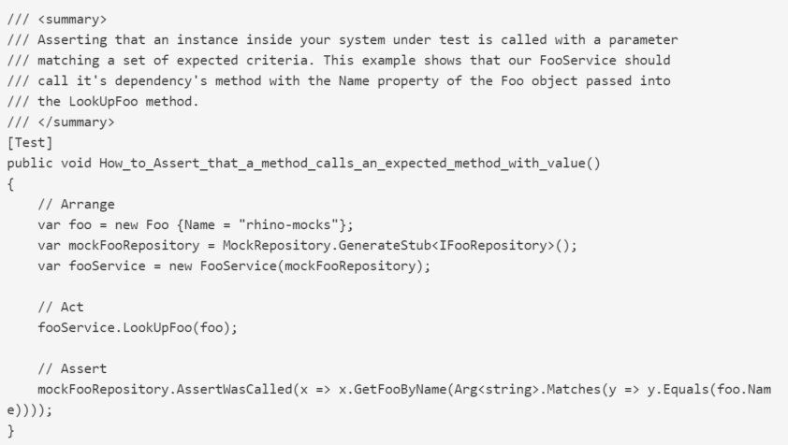
Isolation Frameworks - Rhino Mocks
Open source .NET dynamic mocking framework
https://www.hibernatingrhinos.com/Oss/rhino-mocks/learn/Usage/assert-that-a-method-is-called-with-a-value-in-expected-state

Slide 54
Isolation Frameworks - Moq
Another .NET mocking framework for .NET
Provides Linq to Mocks
Doesn’t differentiate mocks from stubs

Slide 55
Isolation Frameworks
Stubs and Mocks with Moq

Slide 56
Stubs vs. Mocks vs. Fakes
From Martin Fowler’s article, “Mocks aren’t stubs:”
Stubs – Provide canned answers to calls made during the tests, usually not responding at all to anything outside what’s programmed in for the test.
Mocks – Objects pre-programmed with expectations which form a specification of the calls they are expected to receive.
Fakes – Objects that actually have working implementations but usually take some shortcut which makes them not suitable for production (e.g. in-memory database)
http://www.martinfowler.com/articles/mocksArentStubs.html

Slide 57
Shims
Modifies the compiled code of application at runtime
Instead of making specified method call, runs shim code that test provides
Can be used to replace calls to assemblies that you can’t modify (e.g. .NET assemblies)

Slide 58
Stubs vs. Shims
Stubs faster than shims
Stubs can implement interfaces only (not static methods, non-virtual methods, sealed virtual methods, etc.)
Stubs can only replace visible methods, shims can replace calls to private methods if all types on method signatures are visible
Stubs -> Isolate from dependencies within codebase
Shims -> Isolate from 3rd party components that don’t have a testable API

Slide 59
Isolation Frameworks - Microsoft Fakes (was Moles)
Visual Studio Enterprise 2015 needed
Shims are a sledgehammer for legacy code
“[Peter Provost] reiterated (with attribution to Martin Fowler) that untested code should not be refactored and that shims are meant to allow you to write temporary tests that allow you to immediately refactor the method while it is under test. Once refactored, and the tests are passing, you should immediately rewrite the unit tests using something other than shims.”
Do not use Shims to test your own new code!

Slide 60
Isolation Frameworks
Shims and Stubs with Microsoft Fakes

Slide 61
What qualities make up good tests?

Slide 62
Bad tests, bad designs
Design smells:
Long setup code
Setup duplication
Long running tests
Fragile tests

Slide 63
What makes up a good unit test?
Automated and repeatable
Simple to implement
Maintainable
Anyone should be able to run it
Runs at the push of a button (or automatically)
Runs quickly

Slide 64
What should you test?
Conditionals
Loops
Operations
Polymorphism
Code that you write (generally)

Slide 65
How does TDD relate to Extreme Programming?
Pairing
Work fresh
Continuous integration
Simple design
Refactoring
Continuous delivery

Slide 66
When should you delete tests?
If two tests are redundant, decide with this criteria:
Never delete a test if it reduces your confidence in the behavior of the system.
If you have two tests that execute the same path through code but speak to different scenarios, leave them alone.
If still redundant, delete the least useful of the two.

Slide 67
Working with legacy code

Slide 68
There’s no easy solution to test legacy code.

Slide 69
Factors that affect testing legacy code
Coupling (the higher the coupling, the harder to test)
Type of application that is being used
Cost of refactoring
Unwillingness to change

Slide 70
Code Metrics

Slide 71
Metric: class coupling
Business Logic
GUI
Transaction
Customer
Account

Slide 72
Metric: class inheritance
Component
Control
ListControl
Label
ComboBox
ListBox
LinkLabel

Slide 73
Metric: lines of code
1 2 3 4 5 6 7-9 | static class Program { #region Application Entry Point /// <summary> /// The main entry point for the application. /// </summary> [STAThread] static void Main(string[] args) { Application.EnableVisualStyles(); Application.SetCompatibleTextRenderingDefault(false); Workflow(args); } #endregion #region Static Methods /// <summary> Primary workflow for the application. </summary> /// <param name="args"> Command line arguments. </param> private static void Workflow(string[] cmdargs) { // Collect the list of command line arguments List<string> args = new List<string>(cmdargs); // Show usage syntax if the user so asks if (UseArg(args, "/?")) { ShowAbout(); return; }

Slide 74
Metric: cyclomatic complexity
bool ParseCommandLine(string[] args)
{
if (args.Length == 0)
{
ShowHelp();
return false;
}
for (int i = 0; i < args.Length; i++)
switch (args[i])
{
case "/?":
ShowHelp();
return false;
case "/input":
if (args.Length > i && File.Exists(args[i + 1]))
InputFile = args[i++];
break;
case "/c":
Collapse = true;
break;
}
return true;
}

Slide 75
Metric: maintainability index
overall indication of complexity by aggregation of several factors
lines of code
cyclomatic complexity
computational complexity
used on the windows base code
$$\text{Maintainability} \text{Index}=171−5.2∗\log_{2}\left(\text{Halstead} \text{Volume}\right)−0.23∗\left(\text{Cyclomatic} \text{Complexity}\right)−16.2∗\log_{2}(\text{Lines} \text{of} \text{Code})$$

Slide 76
Sprout method
When adding a feature to system that can be new code, write code in a new method
Call method from places where new functionality needs to be

Slide 77
Sprout class
When adding a feature to system that can be new code, write code in a new method
Call method from places where new functionality needs to be

Slide 78
Wrap method

Slide 79
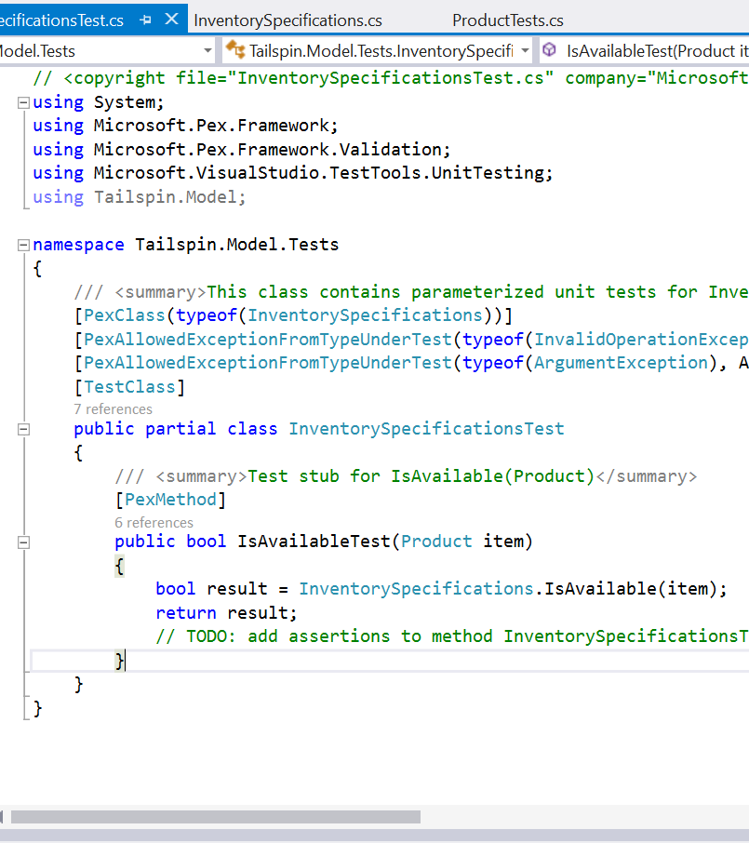
Creating IntelliTests in Visual Studio 2015
Explores .NET code to generate test data and suite of unit tests automatically
Run IntelliTest to see which tests are failing to fix the code
Rerun IntelliTest to keep generated tests in sync with code changes

Slide 80

Further resources for testing legacy code
Working effectively with legacy code by Michael Feathers
http://ecx.images-amazon.com/images/I/51H6SHy6g2L._SX258_BO1,204,203,200_.jpg

Slide 81
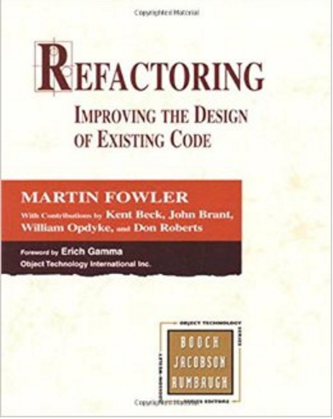
Refactoring, in 464 pages
Refactoring: Improving the Design of Existing Code by Martin Fowler
http://ecx.images-amazon.com/images/I/512-aYxS4ML._SX258_BO1,204,203,200_.jpg

Slide 82
TDD Patterns and Practices

Slide 83
Red/Green/Refactor
Write a failing unit test.
Red
Green
Refactor
Refactor your draft code
into a final version
Code just enough to
make the unit test pass

Slide 84
Red Patterns
Starter Tests – start with the simplest possible test to keep it simple
Regression Tests – every time you have a bug, start with a test to prove the bug
Smaller Tests – when it takes too long to ‘get to green’, create a smaller test first
Test showing only the breaking change, then go back to big one
Mock Objects – fake version of objects which rely on expensive, complicated or external resources
Broken Test / Clean Check In
When working alone, leave with a broken test; when in a team, leave with all tests passing

Slide 85
Green Patterns
Triangulate – abstract only when you have two or more examples
Fake it – implement functionality with a constant to get started
Obvious implementation – if the implementation is obvious, just do it (quickly)
One to Many – when working with collections, start with a single element
Fixture – refactor repeated code into a setup method that is called for each test

Slide 86
Refactor Patterns
Design patterns – know your Gang of Four design patterns
Command, Value, Null object, Pluggable Object, Factory Method, Imposter, Composite, Singleton, etc
SOLID – in object oriented programming keep the SOLID acronym in mind
Single responsibility, Open-closed, Liskov substitution, Interface segregation and Dependency inversion
Isolate Change – keep your change to a small subset of your code, if possible
Extract method – if a method is getting to complicated, extract a small subset
Extract interface – to mock or use dependency injection in compiled, object oriented languages extract an interface

Slide 87
Extending TDD

Slide 88
Paths to grow from TDD
Code Coverage – Calculating how much of your code is covered by your tests
ATDD – Acceptance Test Driven Development
BDD – Behavior Driven Development
Dependency Infection / Inversion of Command

Slide 89
Other tools to extend TDD practices
Using code coverage in Visual Studio 2015
Creating IntelliTests in Visual Studio 2015
Using Cucumber/Specflow in Visual Studio 2015

Slide 90


Code coverage
Drill down into your classes to see exactly which methods are not covered
Do not overanalyze this metric
100% is not reasonable coverage

Slide 91
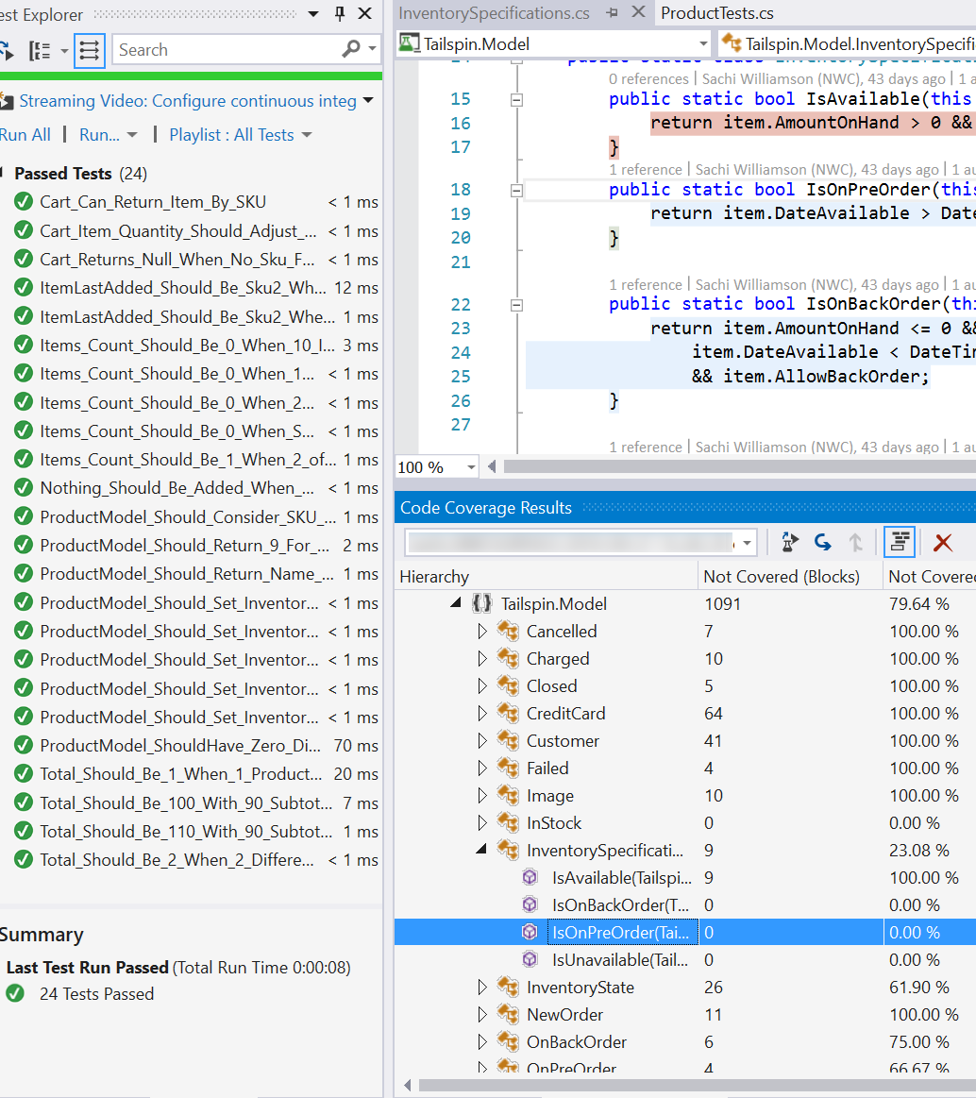
Display completeness of testing efforts
Use Code Coverage to analyze the blocks of code in your solution that is covered
Drill down to methods to view lines of code covered and not covered

Slide 92
Acceptance TDD (ATDD)
Create single acceptance test
Write just enough production functionality/code to fulfill the test
Specify detailed, executable requirements on just-in-time (JIT) basis

Slide 93
Behavior-Driven Development (BDD)
Derived from domain-driven design, building pieces of functionality consecutively
Usually executed in natural language format, also uses “Given…When…Then…”
Focuses on behavior of application, requirements and tests
https://en.wikipedia.org/wiki/Behavior-driven_development

Slide 94
Binding business requirements to .NET code with Specflow
Part of the Cucumber family of products
Corresponds to Behavior-Driven Development (BDD) and Acceptance Test-Driven Development (ATDD)
Describe behavior of system using human-readable syntax with specifications
Bind test specifications to application code for automated testing

Slide 96
Quotes
"Whenever you are tempted to type something into a print statement or a debugger expression, write it as a test instead."
- Martin Fowler
“Once you've been test infected, your attitude toward development is likely to change.”
- Erich Gamma

Slide 97
Automated tests and Visual Studio 2015

Slide 98
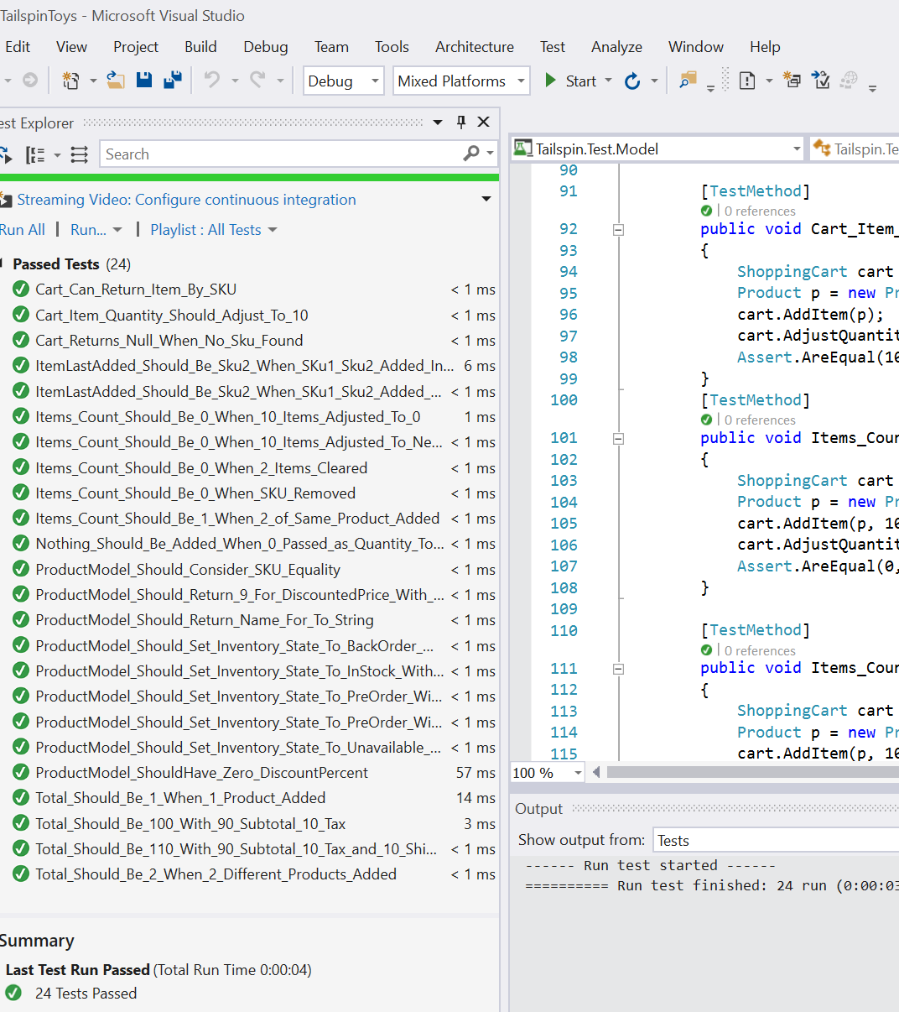
Running tests in Test Explorer
View results of all automated tests in a single window
Run playlists of tests for organization
Choose to run tests in parallel

Slide 99
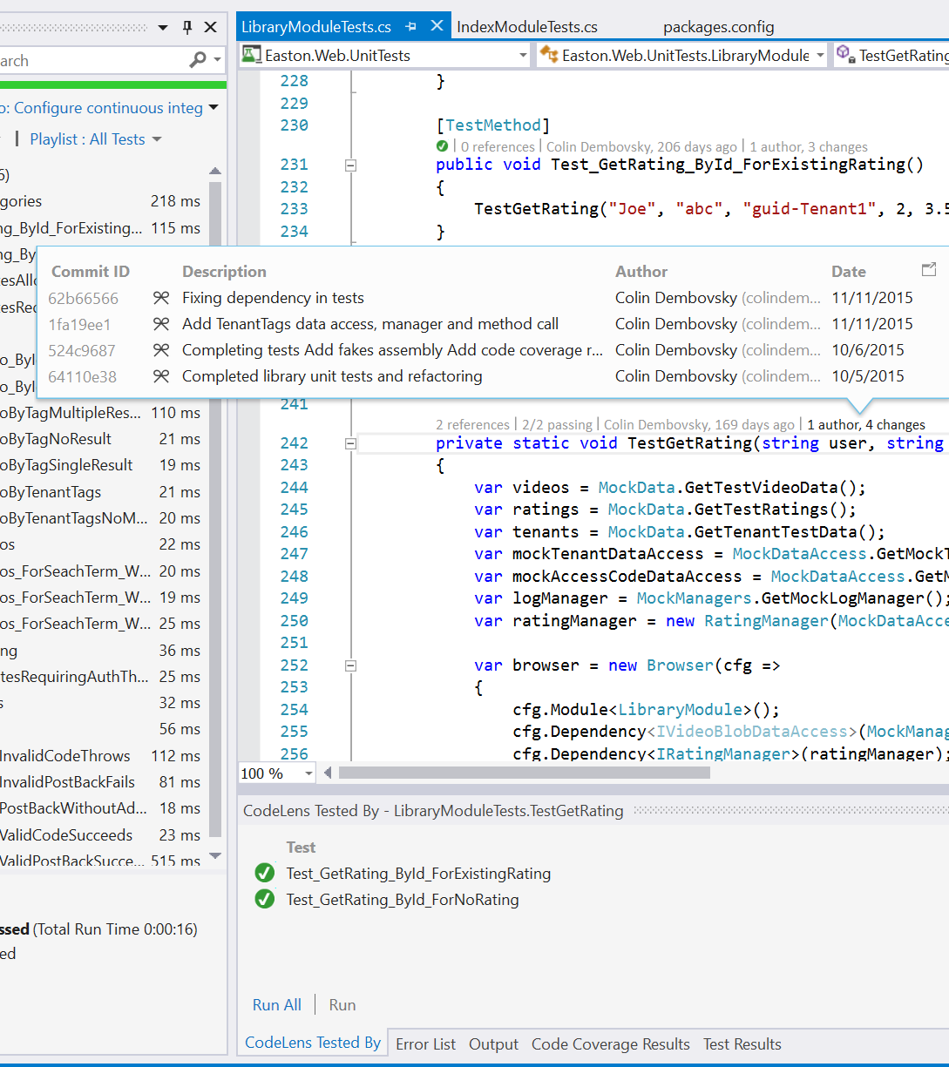
Viewing unit test history with CodeLens
Find information about code quickly
such as references, linked items in TFS, unit tests
Opens heads-up display before functions
Contact team in same window

Slide 100
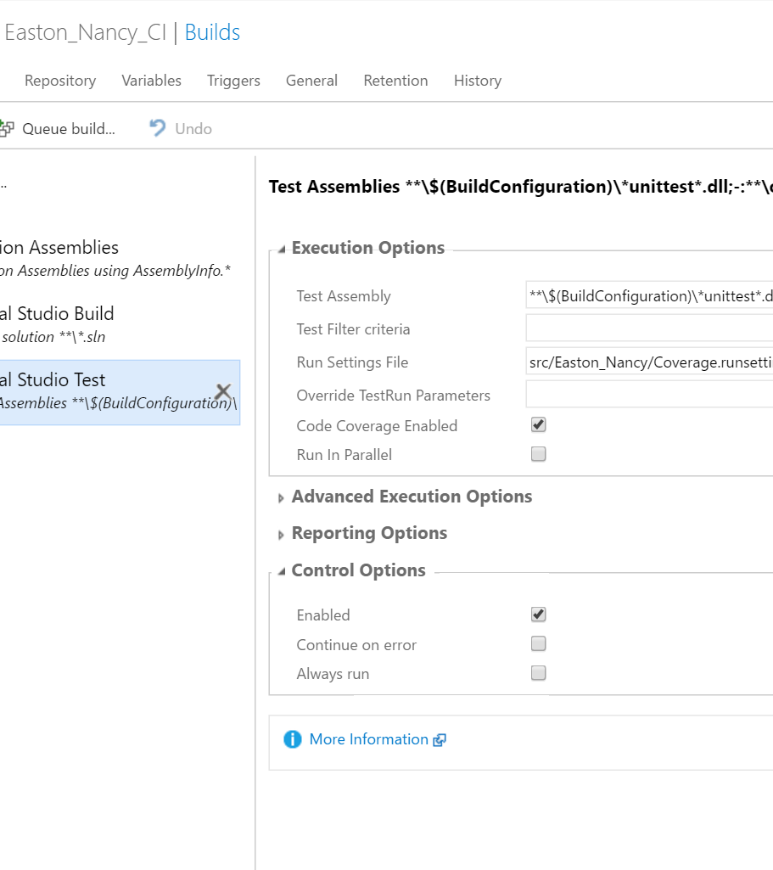
Triggering automated tests in build
Run automated tests at build time when including references to test projects in build tasks
View test results in build summary and optionally enable Code Coverage results

